Slide 1
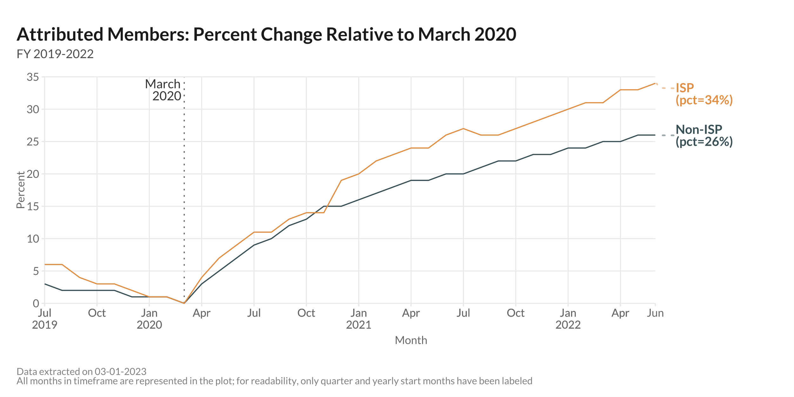
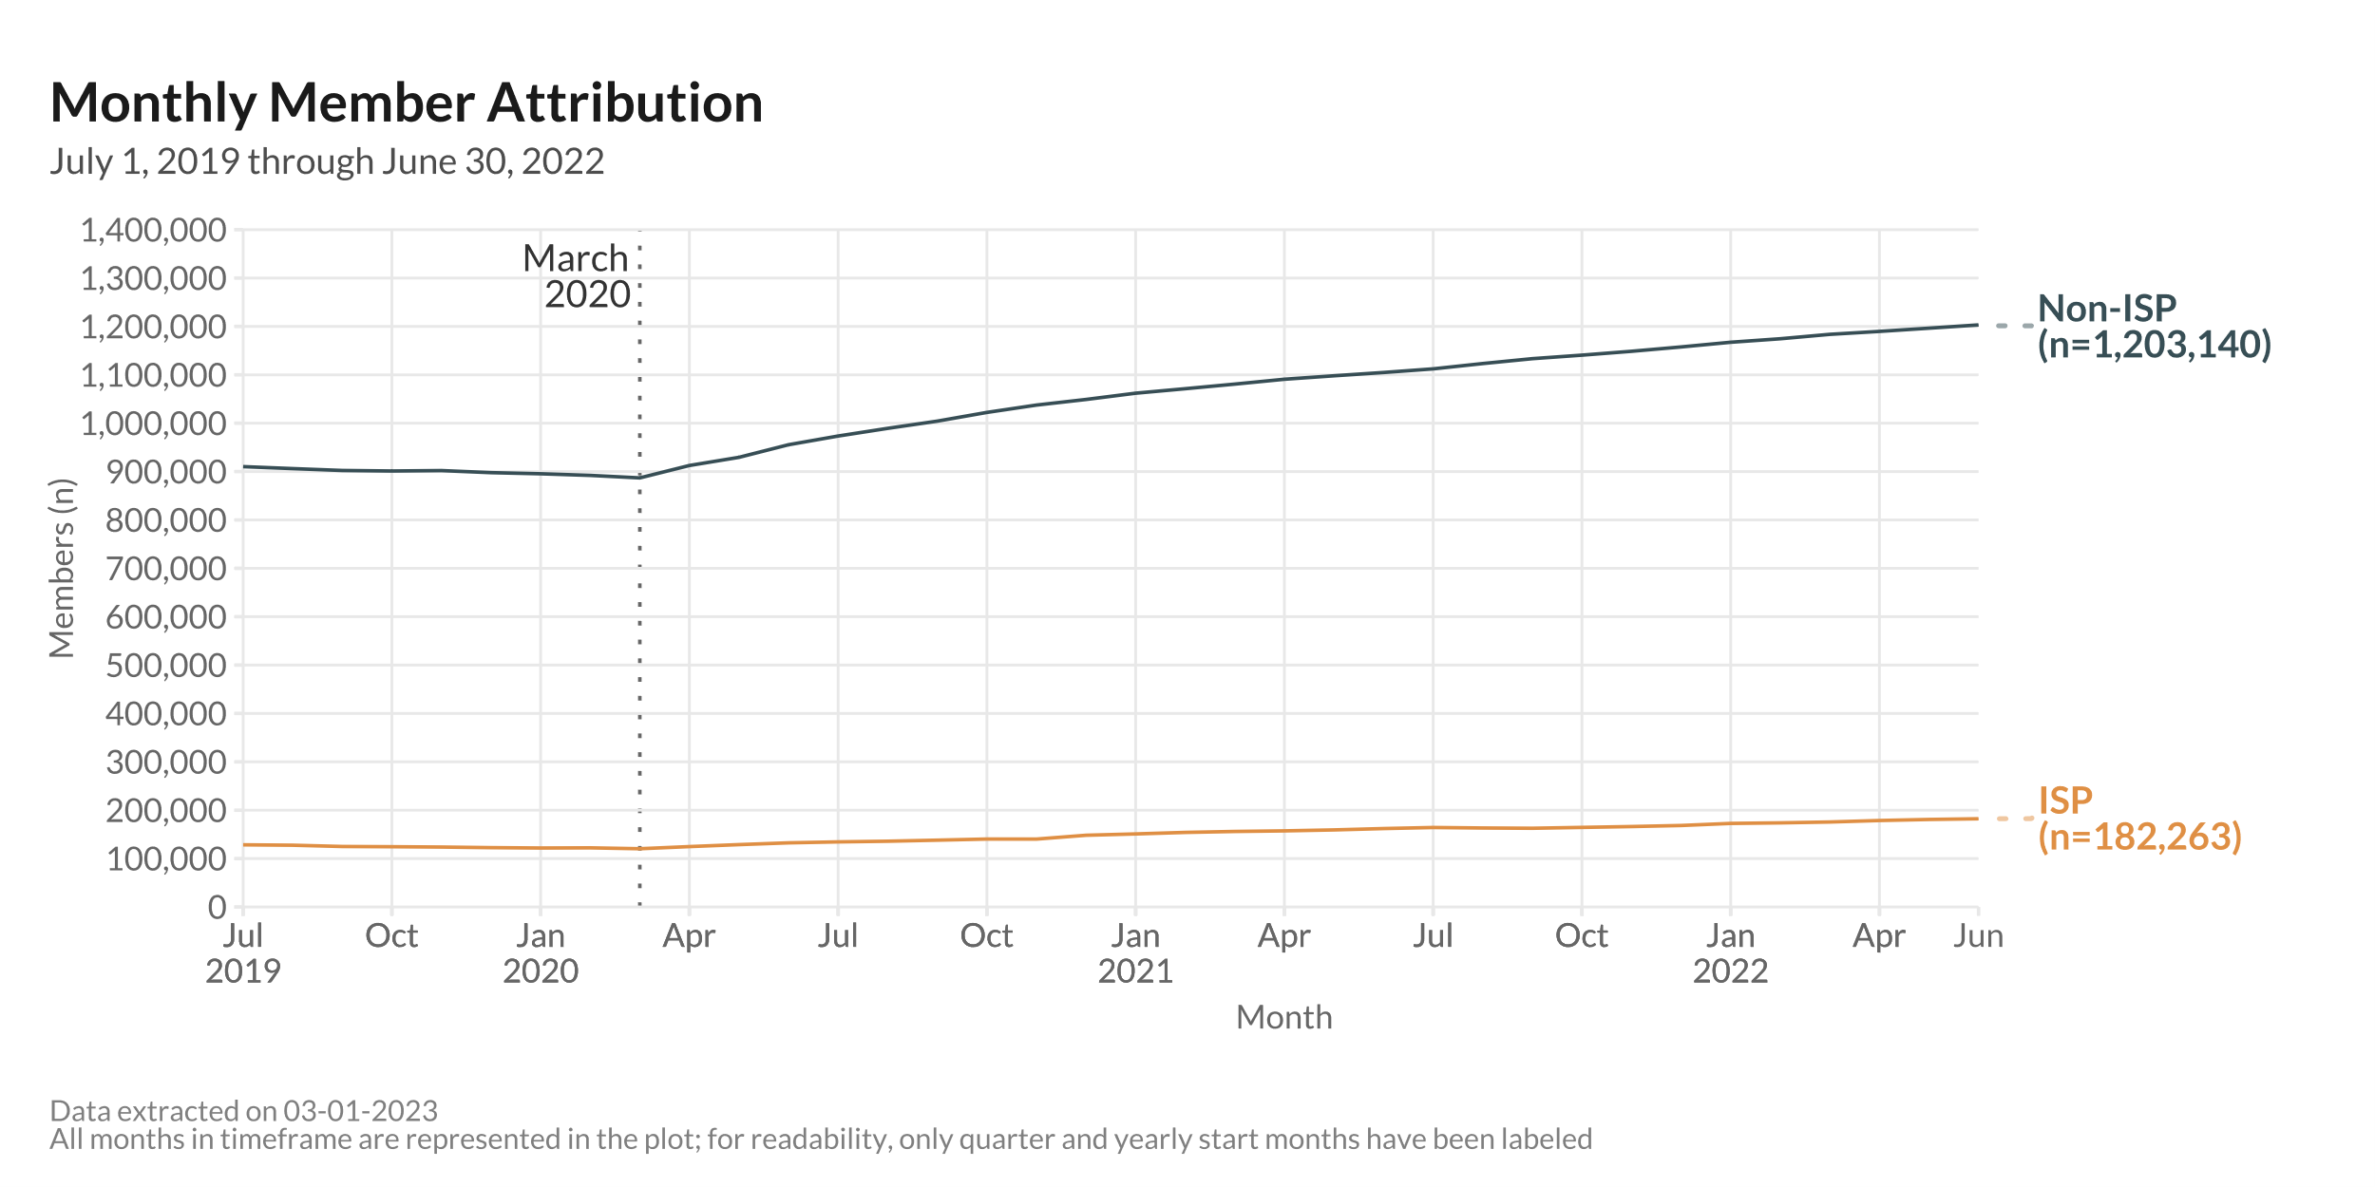
Notes:
Month Range: July 2019 – June 2022 (3 Fiscal Years)
ISP vs non-ISP unique members attributed per month

Slide 2
Notes:
Month Range: July 2019 – June 2022 (3 Fiscal Years)
ISP vs non-ISP unique members attributed per month

Slide 3
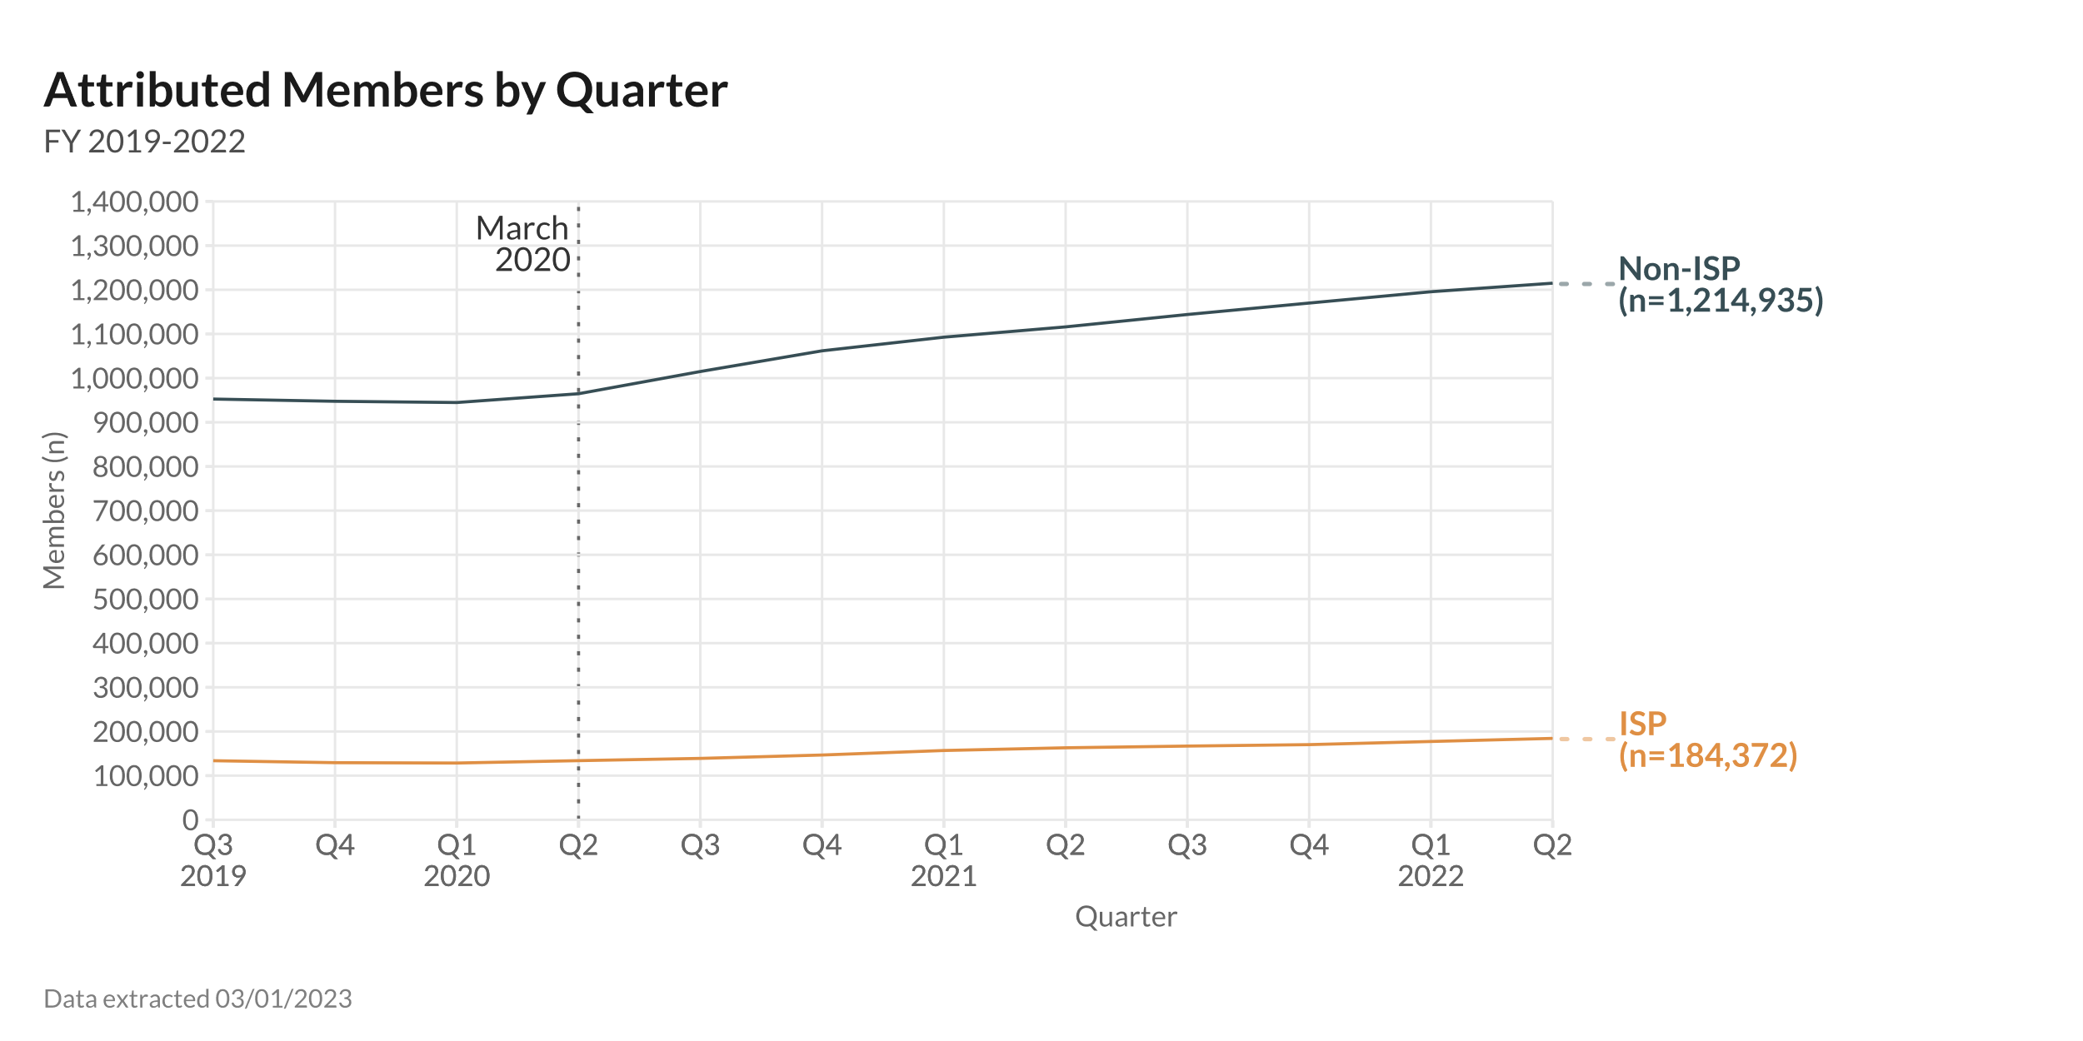
Notes:
Month Range: July 2019 – June 2022 (3 Fiscal Years)
ISP vs non-ISP unique members attributed per month

